Slide 1
Philippians 2:1-11 (NIV)
1If you have any encouragement from being united with Christ, if any comfort from his love, if any fellowship with the Spirit, if any tenderness and compassion, 2 then make my joy complete by being like-minded, having the same love, being one in spirit and purpose. 3 Do nothing out of selfish ambition or vain conceit, but in humility consider others better than yourselves. 4 Each of you should look not only to your own interests, but also to the interests of others. 5 Your attitude should be the same as that of Christ Jesus:

Slide 2
Philippians 2:1-11 (NIV)
6 Who, being in very nature God, did not consider equality with God something to be grasped, 7 but made himself nothing, taking the very nature of a servant, being made in human likeness. 8 And being found in appearance as a man, he humbled himself and became obedient to death-- even death on a cross! 9 Therefore God exalted him to the highest place and gave him the name that is above every name, 10that at the name of Jesus every knee should bow, in heaven and on earth and under the earth, 11and every tongue confess that Jesus Christ is Lord, to the glory of God the Father.

Slide 5
Providing Christmas Relief Packages to Children in need in Khayelitsha Township, South Africa
helpct.org/siphos-stars

Slide 6
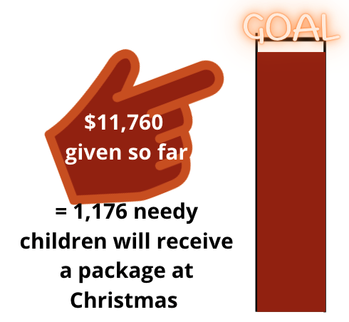
RCC $3,150
helpct.org/siphos-stars

Slide 7
You can still donate!
We are accepting donations up until July 24 for 2022
helpct.org/siphos-stars

Slide 10
Good relationships
[as far as it depends on us]
indicate maturity
Love the Lord your God … Love your neighbour as yourself
MATTHEW 27:37-40

Slide 11
Paul, his colleagues and the Philippian Christians are great examples
Philippians
1:1-9; 1:19; 1:25; 2:1-11; 2:19-23; 2:25-30; 4:14-19
See also: 4:1-2 & 4-5

Slide 12
Meet People
- seek relationships -
from the first day [1:5]

Slide 13
Meet People
- seek relationships -
first day of meeting ?
first day of believing ?
ACTS 16:11-40
Paul actively sought people out and as they were open, relationships were formed.

Slide 14
Be Reliable
- behave consistently-
your partnership …from the first day until now[1:5]

Slide 15
Work Together
- build shared experience -
your partnership in the gospel [1:5]

Slide 16
Demonstrate Affection
- say how you feel -
I have you in my heart and … I long for all of you with the affection of Christ Jesus. [1:7-8]

Slide 17
Stay Humble
- put others first -
In your relationships with one another, have the same mindset as Christ Jesus [2:5]

Slide 18
Stay Humble
- put others first -
Don’t be vainly conceited or have selfish ambition, but consider others better than yourself
Behave like Jesus who gave everything up for us
PHILIPPIANS 2:1-11

Slide 19
Make an Effort
- Invest yourself -

Slide 20
PAUL expressed his affection 1:3-5
Make an Effort
- invest yourself -
spoke life into them 1:6
prayed for them 1:4 & 9
sought their prayers 1:9
worked for their good 1:25
sent Timothy to them 2:19-22
returned Epaphroditus 2:25-30

Slide 21
PHILIPPIANS
Make an Effort
- invest yourself -
prayed for Paul 1:9
sent Epaphroditus to Paul 2:25-30
supported Paul financially 4:14-19

Slide 22
BEHAVE IN WAYS THAT MAKE RELATIONSHIPS BETTER
Do everything without grumbling or arguing (2:14)
Let your gentleness be evident to all (4:5)

Slide 23
WHEN THINGS GO WRONG (AND THEY WILL), FIX IT
PHILIPPIANS 4:2-3

Slide 24
RECIPROCITY IN RELATIONSHIPS IS THE BEST
WE DON’T ALWAYS GET RECIPROCITY
NO RECIPROCITY? STILL DOING OUR PART IS A SIGN OF MATURITY
MATTHEW 5:44 & ROMANS 12:8

Slide 25
WATCH YOUR HEART
DO YOUR PART
SEE WHAT GOD DOES

